Slide 1
Temporal Fairness in Multiwinner Voting Edith Elkind University of Oxford Alan Turing Institute

Slide 2
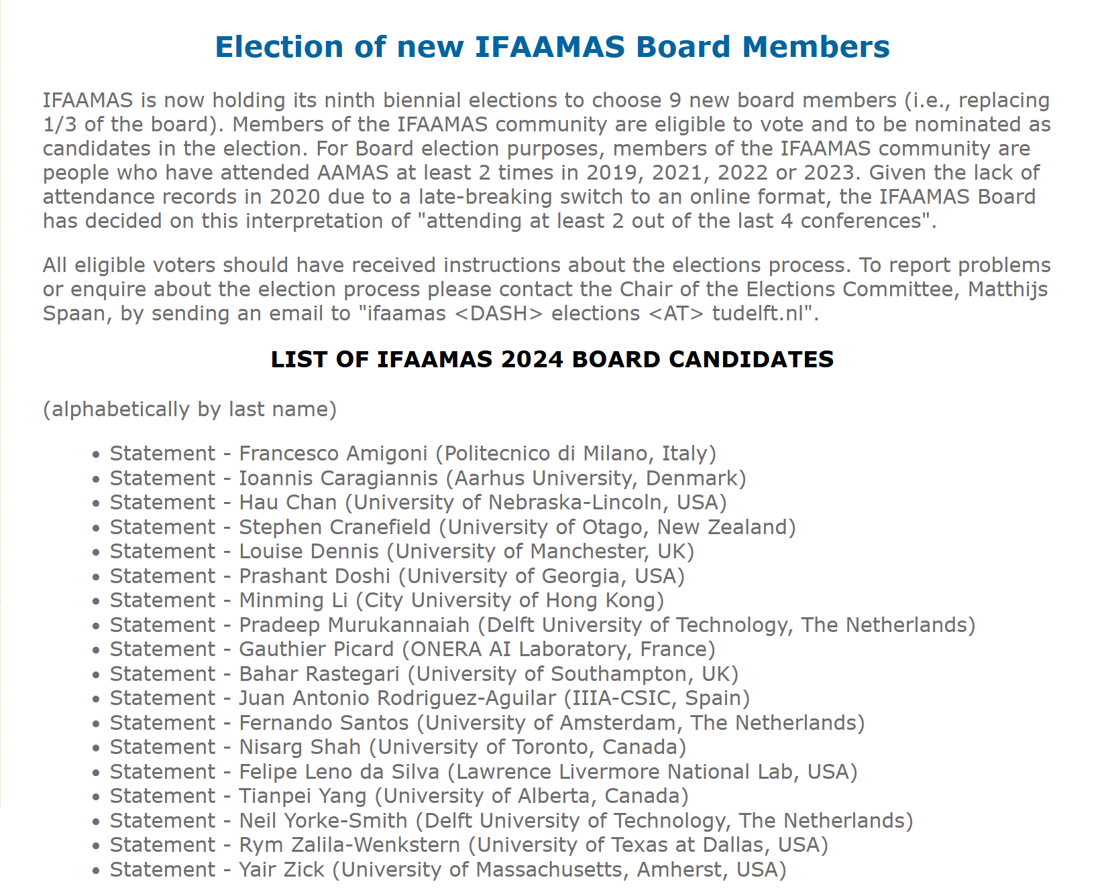
How to Select Your Governing Body
IFAAMAS:
27-member board
9 members replaced every 2 years
approval voting
variable set of voters

Slide 3
How to Appoint Conference Chairs
IJCAI board of trustees, AAAI conference committee of the Executive Council
Task: select PC chair(s) and general chair
Need to
represent diverse research areas and geographic regions
respect gender balance
short-term and long-term
no one serves twice

Slide 4
How to Plan Your Holiday
Simpsons go on a 3-day holiday
Activities:
water park zoo museum shopping
What should they do each day?

Slide 5
Preferences
 | Day 1 | Day 2 | Day 3

Slide 6
Voting Over Time
Decisions made repeatedly over time
elections for governing bodies
event organisation
Basic model:
set of rounds T
set of voters N_{t}
set of projects/candidates P_{t}
in each round, each voter in N_{t} has preferences over P_{t}

Slide 7
Modeling Dimensions
Outcome:
single vs multiple winners in each round
duration of service
Availabilities/preferences
static vs evolving
Online vs offline
Desiderata
individual vs group satisfaction
Satisfaction
in each round vs for each prefix vs cumulative vs periodic

Slide 8
This Talk: Formal Model
n voters, set of m projects P, l rounds
In each round, voters express approval preferences over P: s_{i, r} ⊆ P
In each round, a single project is selected
Outcome: schedule σ = (σ₁, ..., σ_{l} )
This work: each project is selected at most once
σ_{i} ≠ σ_{j} for i ≠ j
Assume: all preferences are given in advance
Assume: no strategic behavior

Slide 9
Goals
Voter’s utility from an outcome: # of rounds where they approve the selected project: u_{i}(σ) = |{r ∈ [l]: σ_{r} ∈ s_{i, r}}|
We may want to maximize:
sum of utilities (utilitarian SW)
min utility (egalitarian SW)
We may want to ensure:
Pareto optimality
Fairness notions

Slide 10
outcome 1
outcome 2
outcome 3
H:0, M:1, B:1, L:2
H:0, M:1, B:2, L:2
H:1, M:1, B:2, L:1

Slide 11
Hard and Easy Problems
Util vs egal welfare: which one is harder?
Observation: utilitarian welfare maximization is poly-time
Proof:
we are matching projects to rounds
weight of an edge: number of approvals
we want a max-weight matching (easy)
projects
rounds
who likes p at r?
p
r

Slide 12
Complexity of Egalitarian Welfare
Theorem: egalitarian welfare maximization (EWM) is NP-hard
But what if m, n, or l is “small”?
Easy for small m (FPT) or l (XP)
Theorem: for 2 agents EWM is at least as hard as Exact Matching
bipartite graph, each edge is red or blue
is there a perfect matching with exactly K red edges?
admits a randomized poly-time algorithm
not known if there is a deterministic one

Slide 13
Good News
Positive result: a randomized algorithm for egal SW maximization
and other hard problems, e.g., Pareto optimality
Runtime: polynomial in (m+1)^{n}
polynomial for a small number of agents
Approach:
iterate through all ≤ (m+1) ^{n} utility profiles
check if a given utility profile is achievable
Technical tool: polynomial identity testing

Slide 14
Warm-up: Edmonds Matrix
0 | x_{1, 2} | 0 | x_{1, 4} | 0
x_{2, 1} | 0 | 0 | 0 | 0
0 | 0 | 0 | 0 | x_{3, 5}
0 | x_{4, 2} | 0 | x_{4, 4} | 0
0 | 0 | x_{5, 3} | 0 | 0
A_{G}
G: balanced bipartite n x n graph
det(A_{G}): polynomial over n² vars
G

Slide 15
Determinant of the Edmonds Matrix
0 | x_{1, 2} | 0 | x_{1, 4} | 0
x_{2, 1} | 0 | 0 | 0 | 0
0 | 0 | 0 | 0 | x_{3, 5}
0 | x_{4, 2} | 0 | x_{4, 4} | 0
0 | 0 | x_{5, 3} | 0 | 0
A_{G}
Fact: det(A_{G}) is not identically 0 iff G admits a perfect matching
G
Testing algorithm: draw x_{i, j} randomly from a large finite field, evaluate det(A_{G})

Slide 16
Extension: Schedule Matrix
Assume m = l (wlog)
a(i, p, r) = 1 if i approves p at r
weight of edge (p, r):
x_{p, r} y_{n+1} if no one approves p at r
x_{p, r} y₁^{a(1, p, r)}.… y_{n}^{a(n, p, r)} otherwise
Schedule matrix S: (w_{p, r} ) _{p∈P, r ∈[l]}
det(S): determinant of S
p
r
w_{p, r} =

Slide 17
Determinant of the Schedule Matrix×
x_{p, r} y_{n+1} if no one approves p at r x_{p, r} y₁^{a(1, p, r)}.… y_{n}^{a(n, p, r)} otherwise
det(S): sum of monomials of the form C(x) × y₁^{u(1)}.… y_{n}^{u(n)} y_{n+1}^{u(n+1)}
This monomial is not identically zero iff there exists a schedule that
guarantees utility u(i) to agent i, and
contains u(n+1) “useless” periods
w_{p, r} =

Slide 18
Computing Determinants
How do we check that a particular monomial appears in det(S)?
det(S): m² x-variables and n y-variables
Symbolically compute det(S)?
using the formula: m! terms
Gaussian elimination (or similar): exp over #indeterminates
Alternative approach:
draw x’ randomly: det(S(x’, y)) is a function of y₁, …, y_{n+1}
evaluate by polynomial interpolation

Slide 19
Further Work
Also in the paper: importing fairness notions from the fair division literature
equitability, proportionality (up to k slots)
Group fairness (justified representation etc):
BHPRT’21, CGP’24, EOT’24
Future work
projects with non-unit duration
better dependence on n?

