Slide 1


Quantum Cryptography
Christian Schaffner
Research Center for Quantum Software
Institute for Logic, Language and Computation (ILLC)
University of Amsterdam
Centrum Wiskunde & Informatica
QuSoft Seminar
Friday, 22 January 2016

Slide 2
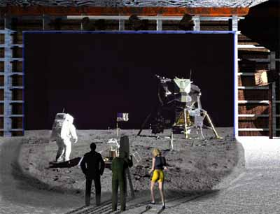
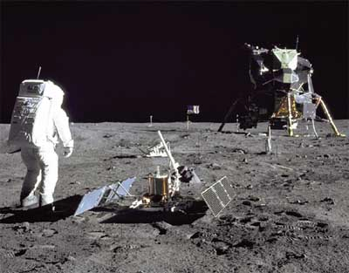
1969: Man on the Moon
The Great Moon-Landing Hoax?
NASA
http://www.unmuseum.org/moonhoax.htm
How can you prove that you are at a specific location?
Notes:
In 1969, man has first set foot on the moon, as you can see here on this picture sent around the world by NASA...
Or not? Maybe it was all just a “great moon-landing hoax”, as speculated on various conspiracy-theory websites on the internet?
One fascinating cryptographic question I want to study in my project is: “How can you prove that you are at a specific location?”
More about it later…

Slide 3
What will you learn from this Talk?
Introduction to Quantum Mechanics
Quantum Key Distribution
Position-Based Cryptography
Notes:
only scattered relations to logic, I’m afraid

Slide 4
Quantum Bit: Polarization of a Photon
q
u
b
i
t
a
s
u
n
i
t
v
e
c
t
o
r
i
n
C
2

Slide 5
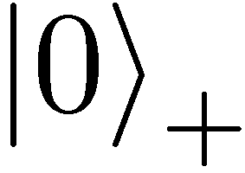
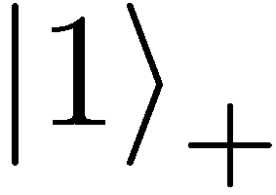
Qubit: Rectilinear/Computational Basis

Slide 6


Detecting a Qubit
No photons: 0
Alice
Bob

Slide 7
Measuring a Qubit
No photons: 0
Photons: 1
Alice
Bob
Measurement:
with prob. 1 yields 1
0/1

Slide 8
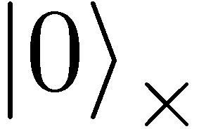
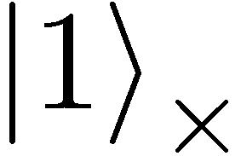

Diagonal/Hadamard Basis
Measurement:
with prob. ½ yields 0
=
with prob. ½ yields 1
0/1

Slide 9
Measuring Collapses the State
Measurement:
with prob. ½ yields 0
=
with prob. ½ yields 1
0/1

Slide 10
Measuring Collapses the State
=
=

Slide 11
Quantum Mechanics
+ basis
£ basis
Measurements:
with prob. 1 yields 1
0/1
with prob. ½ yields 0
0/1
with prob. ½ yields 1

Slide 12
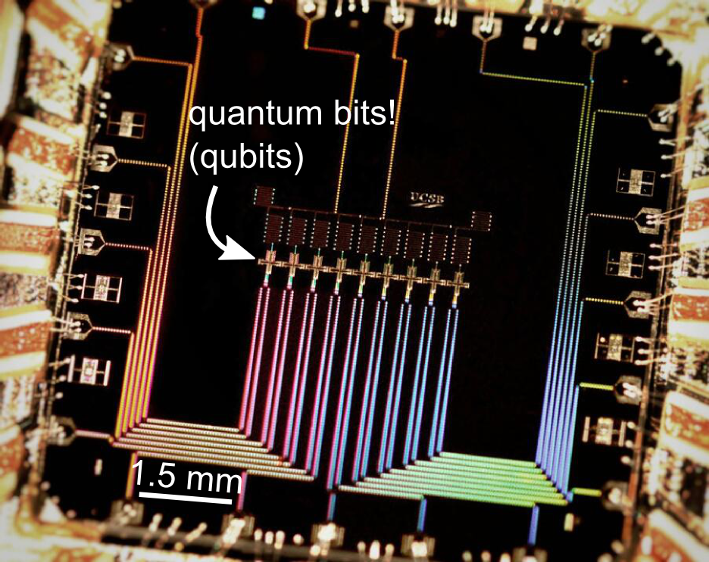
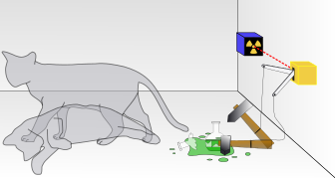

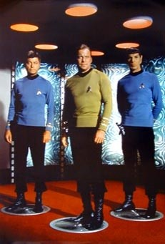
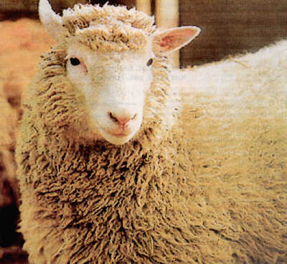
Wonderland of Quantum Mechanics
Notes:
better picture of Schroedinger’s cat

Slide 13
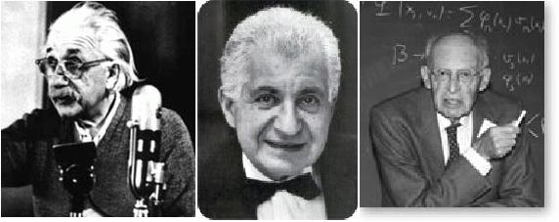

EPR Pairs
[Einstein Podolsky Rosen 1935]
prob. ½ : 0
prob. ½ : 1
EPR magic!
prob. 1 : 0
“spukhafte Fernwirkung” (spooky action at a distance)
EPR pairs do not allow to communicate
(no contradiction to relativity theory)
can provide a shared random bit

Slide 14
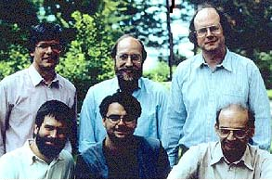

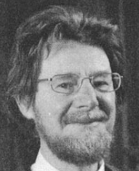




Quantum Teleportation
[Bennett Brassard Crépeau Jozsa Peres Wootters 1993]
?
[Bell]
?
?
quantum one-time pad encryption (applying a random Pauli operation)
does not contradict relativity theory
Bob can only recover the teleported qubit
after receiving the classical information ¾

Slide 15
Demonstration of Quantum Technology
generation of random numbers
50%
50%
(diagram from idQuantique white paper)
no quantum computation, only
quantum communication required

Slide 16
What will you Learn from this Talk?
Introduction to Quantum Mechanics
Quantum Key Distribution
Position-Based Cryptography

Slide 17
No-Cloning Theorem
U
Quantum operations:
?
?
?
Proof: copying is a non-linear operation
Notes:
information vs disturbance trade-off

Slide 18
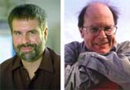

Quantum Key Distribution (QKD)
18
[Bennett Brassard 84]
Alice
Bob
k = ?
k = 0101 1011
Eve
k = 0101 1011
Offers an quantum solution to the key-exchange problem which does not rely on computational assumptions (such as factoring, discrete logarithms, etc.)
Puts the players into the starting position to use symmetric-key cryptography (encryption, authentication etc.).
Notes:
add link to BB84

Slide 19
Quantum Cryptography Landscape
19
attackers systems | efficient classical attacks | efficient quantum attacks | everlasting security (store and break later)
AES | confident | longer keys | brute force
SHA | confident | longer outputs | brute force
RSA, DiscLogs | confident | Shor | brute force
Hash-Based Sign | probably | probably | brute force
McEliece | probably | probably | brute force
Lattice-based | probably | probably | brute force
QKD
physical security
technical difficulty (€)
Post Quantum
Crypto
Notes:
add link to BB84

Slide 20
Quantum Key Distribution (QKD)
20
[Bennett Brassard 84]
0 1 1 1 0
0 0 1 1 0
k = 110
k = 110

Slide 21
Quantum Key Distribution (QKD)
21
[Bennett Brassard 84]
?
?
?
?
?
0 1 1 1 0
0 0 1 1 0
k = ?
k = 10
k = 10
Quantum states are unknown to Eve, she cannot copy them.
Honest players can test whether Eve interfered.

Slide 22

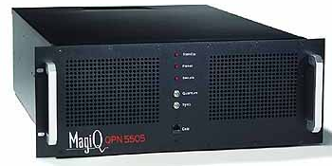
Quantum Key Distribution (QKD)
22
[Bennett Brassard 84]
Alice
Bob
Eve
technically feasible: no quantum computer required,
only quantum communication

Slide 23
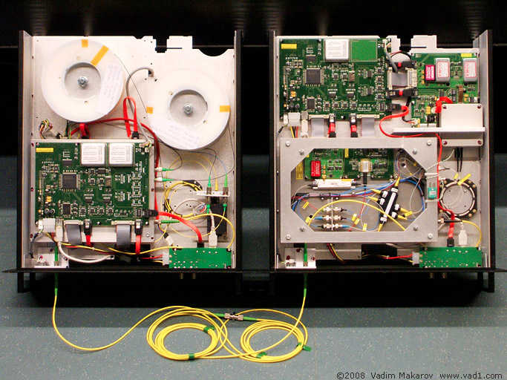
Quantum Key Distribution (QKD)
23
[Bennett Brassard 84]
Alice
Bob
Eve
technically feasible: no quantum computer required,
only quantum communication

Slide 24

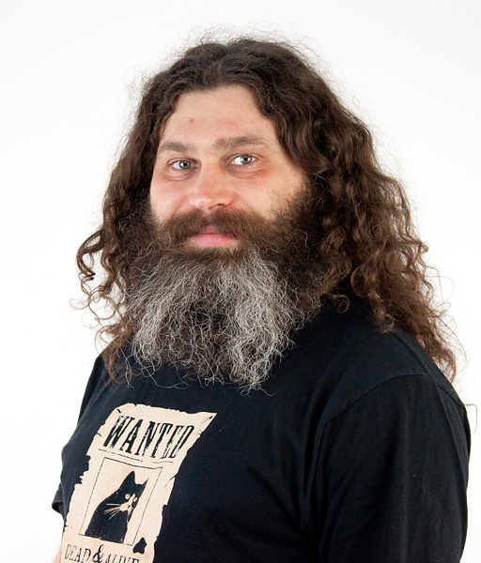
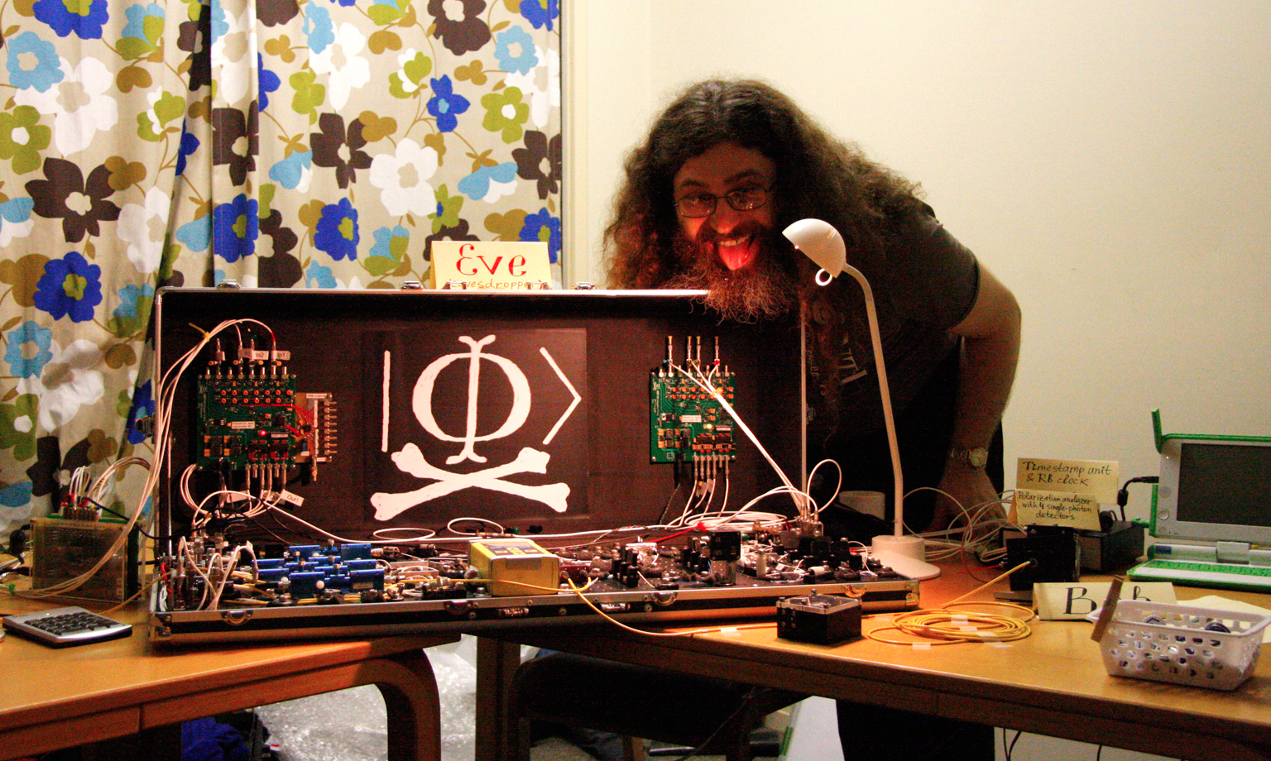
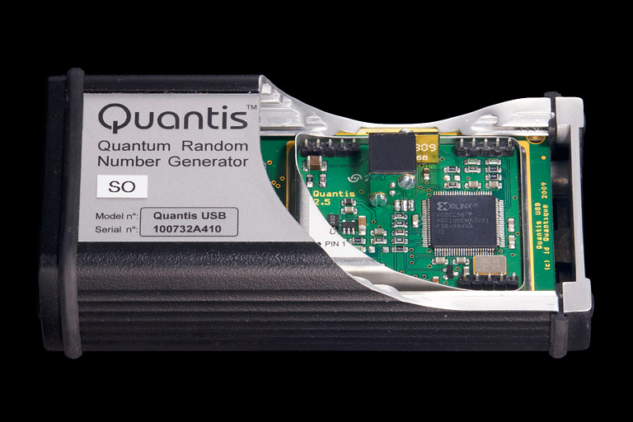
Quantum Hacking
e.g. by the group of Vadim Makarov (University of Waterloo, Canada)

Slide 25
What will you Learn from this Talk?
Introduction to Quantum Mechanics
Quantum Key Distribution
Position-Based Cryptography

Slide 26
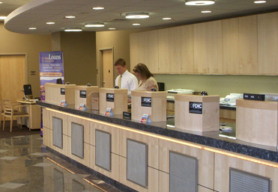
Position-Based Cryptography
Typically, cryptographic players use credentials such as
  secret information (e.g. password or secret key)
  authenticated information
  biometric features
Can the geographical location of a player be used
as cryptographic credential ?

Slide 27
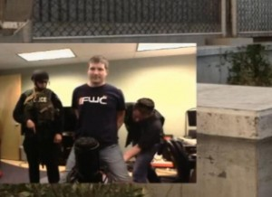
Position-Based Cryptography
Can the geographical location of a player be used as sole cryptographic credential ?
Possible Applications:
  Launching-missile command comes
  from within your military headquarters
  Talking to the correct assembly
  Pizza-delivery problem /
  avoid fake calls to emergency services
  …

Slide 28





Basic task: Position Verification
Verifier1
Prover
Verifier2
Prover wants to convince verifiers that she is at a particular position
no coalition of (fake) provers, i.e. not at the claimed position, can convince verifiers
(over)simplifying assumptions:
    communication at speed of light
    instantaneous computation
    verifiers can coordinate

Slide 29




Position Verification: First Try
Verifier1
Prover
Verifier2
time
distance bounding [Brands Chaum ‘93]

Slide 30
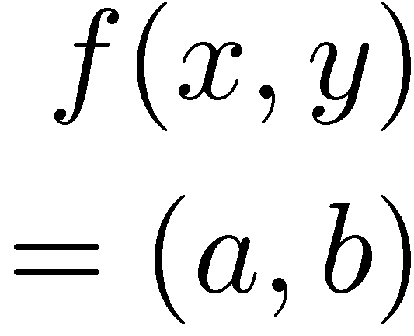


Position Verification: Second Try
Verifier1
Prover
Verifier2
position verification is classically impossible ! [Chandran Goyal Moriarty Ostrovsky 09]
Notes:
classical impossibility proof by [Chandran Goyal Moriarty Ostrovsky: CRYPTO ’09]

Slide 31


The Attack
copying classical information
this is impossible quantumly

Slide 32


Position Verification: Quantum Try
[Kent Munro Spiller 03/10]
?
?
?
Can we brake the scheme now?

Slide 33




Attacking Game
?
?
?
?
?
Impossible to cheat due to
no-cloning theorem
Or not?

Slide 34
Quantum Teleportation
[Bennett Brassard Crépeau Jozsa Peres Wootters 1993]
?
[Bell]
?
?
does not contradict relativity theory
Bob can only recover the teleported qubit
after receiving the classical information ¾

Slide 35
Teleportation Attack
?
?
?
[Bell]
[Bell]
?
?
It is possible to cheat with entanglement !!
Quantum teleportation allows to
break the protocol perfectly.

Slide 36
No-Go Theorem
[Buhrman, Chandran, Fehr, Gelles, Goyal, Ostrovsky, Schaffner 2010] [Beigi Koenig 2011]
Any position-verification protocol can be broken using an exponential number of entangled qubits.
Question: Are so many quantum resources really necessary?
Does there exist a protocol such that:
  honest prover and verifiers are efficient, but
  any attack requires lots of entanglement
see http://homepages.cwi.nl/~schaffne/positionbasedqcrypto.php for recent developments

Slide 37
What Have You Learned from this Talk?
Quantum Mechanics
  Qubits
  No-cloning
  Entanglement
  Quantum Teleportation

Slide 38
What Have You Learned from this Talk?
Quantum Key Distribution (QKD)
Position-Based Cryptography

Slide 39
Thank you for your attention!
Questions
check http://arxiv.org/abs/1510.06120 for a survey about quantum cryptography beyond key distribution

